Slide 1
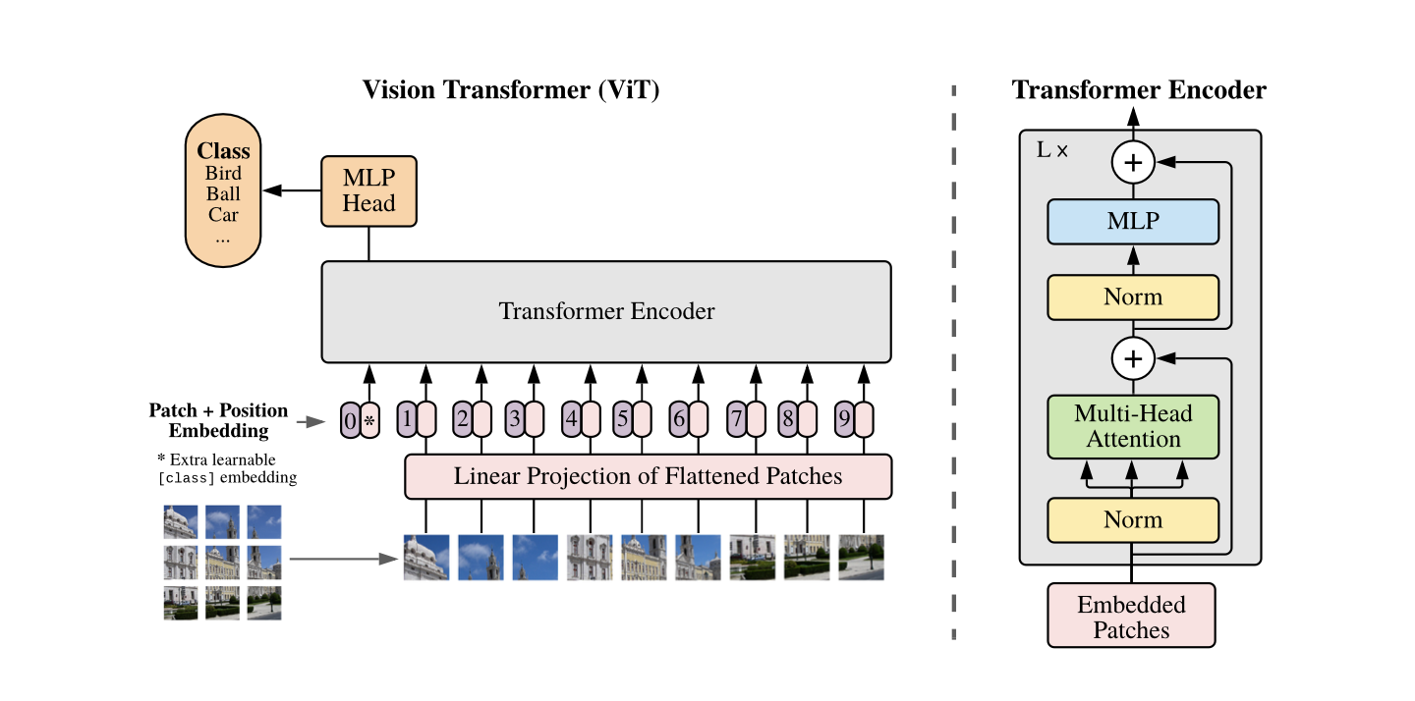
Vision Transformers
An image is worth 16x16 words: Transformers for image recognition at scale, Dosovitskiy et al.,
VIDEO LINK
Jean de Dieu Nyandwi
Carnegie Mellon
Jeande_d @ Twitter
nyandwi.com

Slide 2
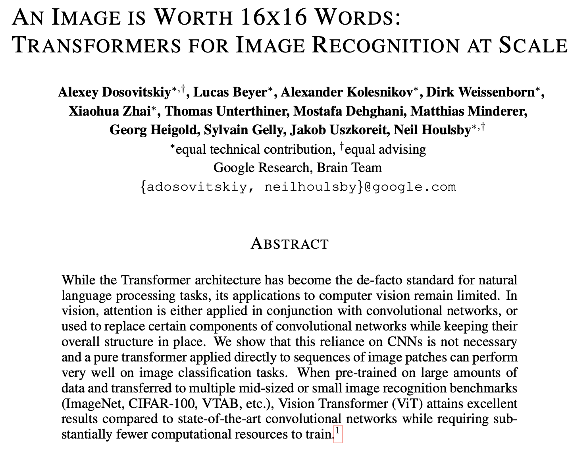

Slide 3
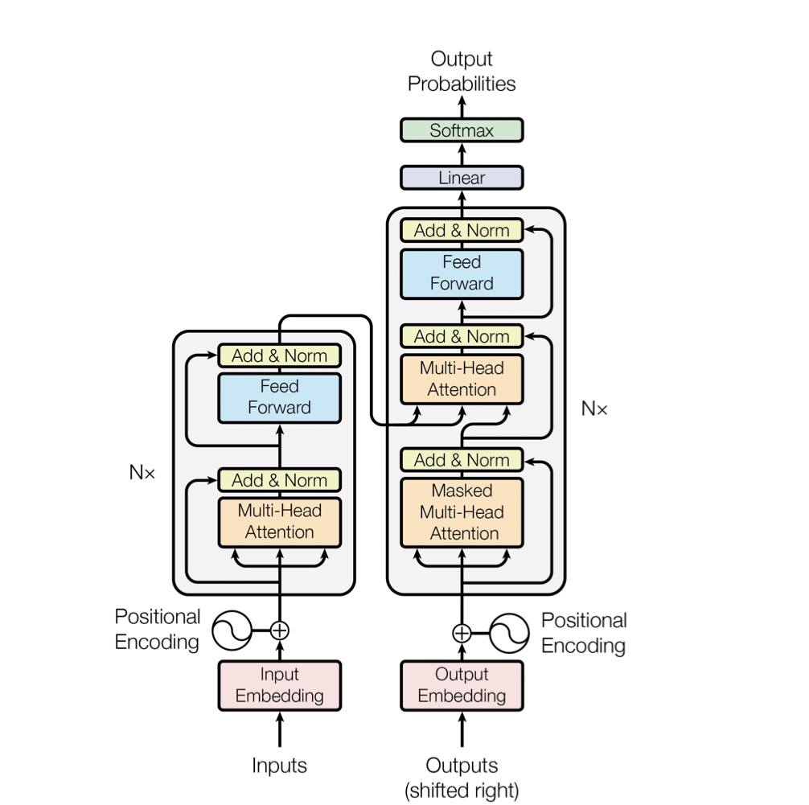

Slide 5

Image: Google AI blog
Notes:
Work on those…there are some holes in there.

Slide 6
Outline of the video
In this video, we will see:
Motivation for ViT
Vision Transformer architecture
Fine-tuning ViT
Training ViT
ViT vs ResNet
Inspecting ViT representations
Self-supervision
Vision Transformers vs CNNs
ViT Implementations
ViTs follow-up works: Scaling ViT, Better plain ViT, How to train your ViT, Scaling ViT to 22B Parameters

Slide 7
Outline of the video
In this video, we will see:
Motivation for ViT
Vision Transformer architecture
Fine-tuning ViT
Training ViT
ViT vs ResNet
Inspecting ViT representations
Self-supervision
Vision Transformers vs CNNs
ViT Implementations
ViTs follow-up works: Scaling ViT, Better plain ViT, How to train your ViT, Scaling ViT to 22B Parameters
Unless mentioned, all images and graphs used in this video are taken from the paper An image is worth 16x16 words: Transformers for image recognition at scale, Dosovitskiy et al..

Slide 8

Motivation for Vision Transformer
Due to Transformer architecture that has extreme scalability and efficiency, pre-training in NLP has been successful. The theme is always pre-training a large Transformer model on large dataset(wikipedia, news, books, codes) and fine-tuning on downstream tasks.
Train a large transformer on large dataset
Finetune on downstream task: text classification, summarization, question answering, etc…

Slide 9
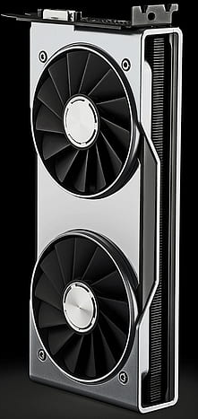




Motivation for Vision Transformer
NLP has been successful due to 3 main ingredients that became happened to be available at the right time: large datasets, powerful and efficient models(Transformer), compute.
Large datasets
Efficient models
Compute

Slide 10
Motivation for Vision Transformer
NLP has been successful due to 3 main ingredients that became happened to be available at the right time: large datasets, powerful and efficient models(Transformer), compute.
Large datasets
Efficient models
Compute
Transformer seems to be the engine of all. Can we apply the same Transformer to image recognition task?

Slide 11
Motivation for Vision Transformer
Before the emergence of Vision Transformer architecture, most works attempted to apply Transformer to computer vision by either:
Replacing all convolution operations with local attention
Combining convolution and attention
Applying Transformer to image pixels directly

Slide 12
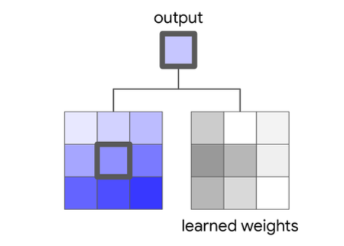
Transformers in Vision: Replacing all Convolution Operations with Local Self-attention Layer
Local convolution
Output: Inner product of convolutional kernel and local window/receptive field.
Ramachandran et al., “Stand-Alone Self-Attention in Vision Models”, 2018

Slide 13
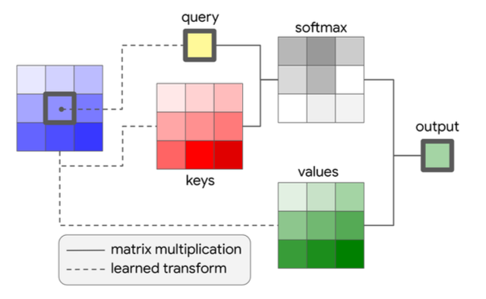
Transformers in Vision: Replacing all Convolution Operations with Local Self-attention Layer
Local self-attention layer
Query: center pixel of local window.
Keys & values: All other pixels of local window.
Local convolution
Output: Standard self-attention applied to receptive field/local window.
Output: Inner product of convolutional kernel and local window/receptive field.
Ramachandran et al., “Stand-Alone Self-Attention in Vision Models”, 2018

Slide 14

Transformers in Vision: Replacing all Convolution Operations with Local Self-attention Layer
Local self-attention layer
Query: center pixel of local window.
Keys & values: All other pixels of local window.
Local convolution
Output: Standard self-attention applied to receptive field/local window.
Output: Inner product of convolutional kernel and local window/receptive field.
Local self-attention is not scalable and hard to implement. Also not compute efficient although attention is computed in local windows.
Ramachandran et al., “Stand-Alone Self-Attention in Vision Models”, 2018

Slide 15
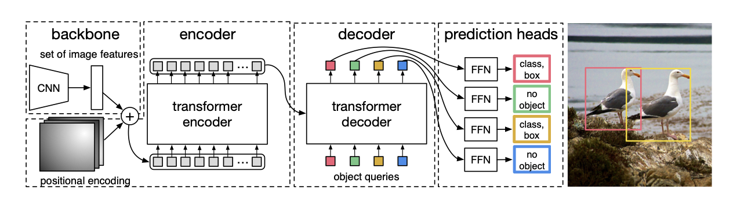
Transformers in Vision: Combining Convolution with Attention
As demonstrated by DETR, combining convolution and attention can result in SOTA in object detection. DETR learns 2D visual features of image with convolutional backbone(ex: ResNet), feed the features to Transformer and predict the box and object class.
Carion et al., “End-to-end object detection with Transformers”, 2020

Slide 16
Transformers in Vision: Combining Convolution with Attention
As demonstrated by DETR, combining convolution and attention can result in SOTA in object detection. DETR learns 2D visual features of image with convolutional backbone(ex: ResNet), feed the features to Transformer and predict the box and object class.
CNNs + Attention seems to work great when done right! DETR is indeed one of the remarkable papers in vision.
Carion et al., “End-to-end object detection with Transformers”, 2020

Slide 17
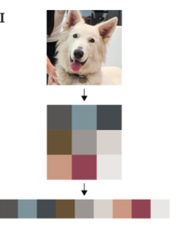
Transformers in Vision: Applying Transformer to Pixels Directly
Treat a raw image as a sequence of pixels just as sentence is a sequence of words in NLP. Resize to low resolution since attention is computational expensive when applied to the whole image and feed the flattened pixels to a normal Transformer to predict the next pixel autoregressively or with masked pixel prediction(like in BERT).
Chen et al., “Generative Pretraining from Pixels”, 2020

Slide 18
Transformers in Vision: Applying Transformer to Pixels Directly
Treat a raw image as a sequence of pixels just as sentence is a sequence of words in NLP. Resize to low resolution since attention is computational expensive when applied to the whole image and feed the flattened pixels to a normal Transformer to predict the next pixel autoregressively or with masked pixel prediction(like in BERT).
Very computationally expensive since each pixel in input image attends to each other!!
Chen et al., “Generative Pretraining from Pixels”, 2020

Slide 19
The main goal of ViT authors were to transfer NLP pretraining success to computer vision and to remove the need of convolution. Given the previous works, the biggest breakthrough in ViT was not applying Transformer to images. It was dividing images into sequence of patches and feeding those patches to standard Transformer encoder.

Slide 20
Vision Transformer Architecture
Divide an input image into non-overlapping patches (16x16x3 each) and flatten them into a sequence of 1D patches
Number of patches N = Effective input sequence length for the Transformer, N = HW/PP, H: width, W: width, P: patch size

Slide 21
Vision Transformer Architecture
Linearly project patches to D(dimension of the model)
Divide an input image into non-overlapping patches (16x16x3 each) and flatten them into a sequence of 1D patches
Number of patches N = Effective input sequence length for the Transformer, N = HW/PP, H: width, W: width, P: patch size

Slide 22
Vision Transformer Architecture
Apply positional embeddings to patches
Linearly project patches to D(dimension of the model)
Divide an input image into non-overlapping patches (16x16x3 each) and flatten them into a sequence of 1D patches
Number of patches N = Effective input sequence length for the Transformer, N = HW/PP, H: width, W: width, P: patch size

Slide 23
Vision Transformer Architecture
Transformer encoder in ViT looks like NLP except layernorm that comes before attention & MLPs
Feed the patches to a normal Transformer encoder.
Apply positional embeddings to patches
Linearly project patches to D(dimension of the model)
Divide an input image into non-overlapping patches (16x16x3 each) and flatten them into a sequence of 1D patches
Number of patches N = Effective input sequence length for the Transformer, N = HW/PP, H: width, W: width, P: patch size

Slide 24
Vision Transformer Architecture
Transformer encoder in ViT looks like NLP except layernorm that comes before attention & MLPs
Add a classification head to perform image classification.
Feed the patches to a normal Transformer encoder.
Apply positional embeddings to patches
Linearly project patches to D(dimension of the model)
Divide an input image into non-overlapping patches (16x16x3 each) and flatten them into a sequence of 1D patches
Number of patches N = Effective input sequence length for the Transformer, N = HW/PP, H: width, W: width, P: patch size

Slide 25
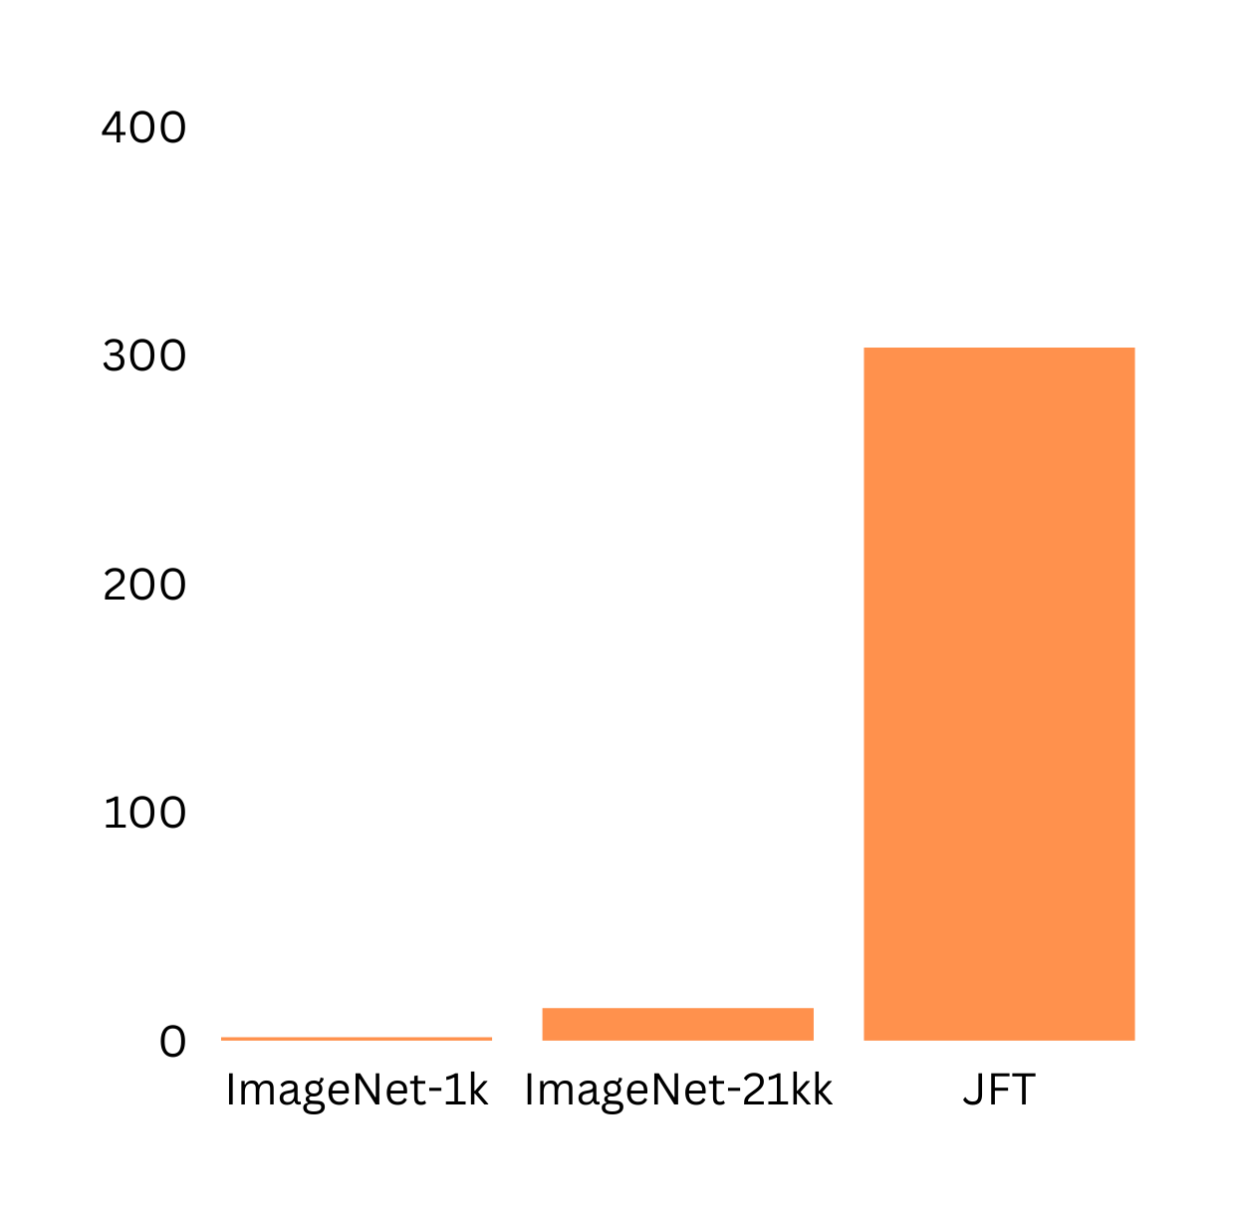
Training Vision Transformer
Vision Transformer(ViT) was pre-trained on 3 datasets of varying size and scale.
Pre-training datasets
303M
ImageNet-1K: 1.3M images, 1K classes
ImageNet-21k: 14M images, 21K classes
JFT: 303M images, 18K classes
No of images in millions(M)
1.3M
14M
ImageNet-1k and ImageNet-21K are also used for fine-tuning!
Datasets

Slide 26
Training Vision Transformer
Vision Transformer(ViT) was pre-trained with same configurations of as BERT.
Model | Layers | Hidden size | MLPs size | Heads | Params
ViT-Base | 12 | 768 | 3072 | 12 | 86M
ViT-Large | 24 | 1024 | 4096 | 16 | 307M
ViT-Huge | 32 | 1280 | 5120 | 16 | 632M
Layers: number of Transformer encoder layers
Hidden size: the dimension of the model
MLPs size: the number of neurons in MLP layers
Heads: number of attention layers in Multi-Head Attention(MHA)
Params: Total parameters

Slide 27
Training Vision Transformer
Vision Transformer(ViT) was pre-trained with same configurations of as BERT.
Model | Layers | Hidden size | MLPs size | Heads | Params
ViT-Base | 12 | 768 | 3072 | 12 | 86M
ViT-Large | 24 | 1024 | 4096 | 16 | 307M
ViT-Huge | 32 | 1280 | 5120 | 16 | 632M
ViT is isotropic architecture - same resolution is maintained across the whole network.
Layers: number of Transformer encoder layers
Hidden size: the dimension of the model
MLPs size: the number of neurons in MLP layers
Heads: number of attention layers in Multi-Head Attention(MHA)
Params: Total parameters

Slide 28
Fine-tuning Vision Transformer
ViT is pre-trained on large datasets and fine-tuned on small downstream datasets. Same as BERT, during fine-tuning, the pre-trained classification head is removed and replaced with zero-initialized DxK(D is hidden size, K is number of downstream classes) classification head.
Classification head

Slide 29
Fine-tuning Vision Transformer
ViT is pre-trained on large datasets and fine-tuned on small downstream datasets. Same as BERT, during fine-tuning, the pre-trained classification head is removed and replaced with zero-initialized DxK(D is hidden size, K is number of downstream classes) classification head.
Fine-tuning details
Downstream datasets: ImageNet(1k & 21k), Cifar-10, Cifar-100, Oxford-III pets, Oxford flowers-102, VTAB(combines natural, specialized, and structured tasks).
Fine-tuning at higher resolutions(384x384) yields better results - ViT is trained at 224x224 resolution. At fixed patch size, higher resolutions results in larger input sequence length. >> N = HW/PP.
You can finetune ViT at any higher resolution since it can handle arbitrary patches length but it may affects pre-trained embeddings.
Classification head

Slide 30
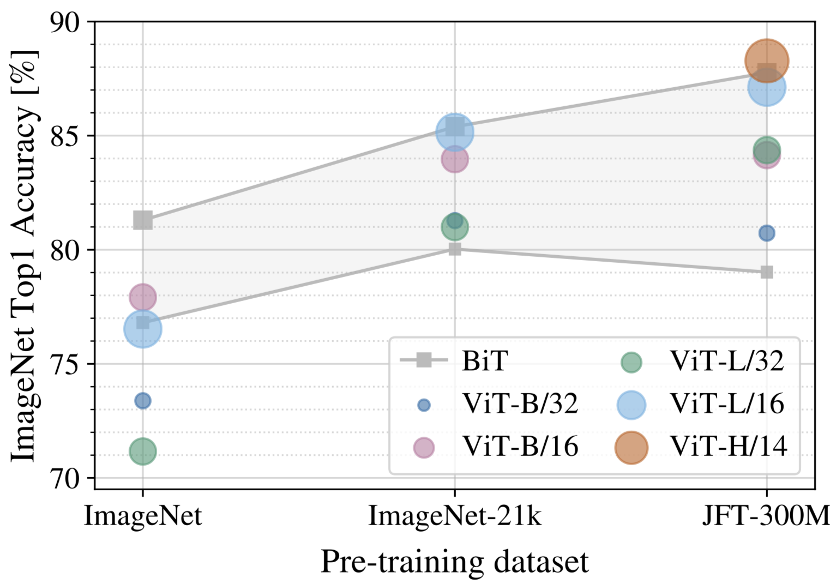
Vision Transformer vs SOTA CNN(ResNet)
B: Base, L: Large, H: Huge
14, 16, 32: Patch size(the smaller patch size, the more the patches, and the bigger the model) >> N = HW/PP
Ex: ViT-B/16: Base ViT with 16x16 patch size
BiT(ResNet): Kolesnikov, “Big Transfer: General Visual Representation Learning”, 2020

Slide 31
Vision Transformer vs SOTA CNN(ResNet)
Results
On small pre-training dataset(ImageNet-1k, 1.3M images), ResNet performs better than ViT due to CNN spatial inductive biases that compensate for small dataset.
B: Base, L: Large, H: Huge
14, 16, 32: Patch size(the smaller patch size, the more the patches, and the bigger the model) >> N = HW/PP
Ex: ViT-B/16: Base ViT with 16x16 patch size
BiT(ResNet): Kolesnikov, “Big Transfer: General Visual Representation Learning”, 2020

Slide 32
Vision Transformer vs SOTA CNN(ResNet)
Results
On small pre-training dataset(ImageNet-1k, 1.3M images), ResNet performs better than ViT due to CNN spatial inductive biases that compensate for small dataset.
On medium pre-training dataset(Imagenet-21k, 14M images), ViTs and ResNet performance are almost similar although ViTs perform slightly better.
B: Base, L: Large, H: Huge
14, 16, 32: Patch size(the smaller patch size, the more the patches, and the bigger the model) >> N = HW/PP
Ex: ViT-B/16: Base ViT with 16x16 patch size

Slide 33
Vision Transformer vs SOTA CNN(ResNet)
Results
On small pre-training dataset(ImageNet-1k, 1.3M images), ResNet performs better than ViT due to CNN spatial inductive biases that compensate for small dataset.
On medium pre-training dataset(Imagenet-21k, 14M images), ViTs and ResNet performance are almost similar although ViTs perform slightly better.
On large pre-training dataset(JFT, 303M images), large ViT outperforms ResNet and show no sign of plateau.
B: Base, L: Large, H: Huge
14, 16, 32: Patch size(the smaller patch size, the more the patches, and the bigger the model) >> N = HW/PP
Ex: ViT-B/16: Base ViT with 16x16 patch size

Slide 34
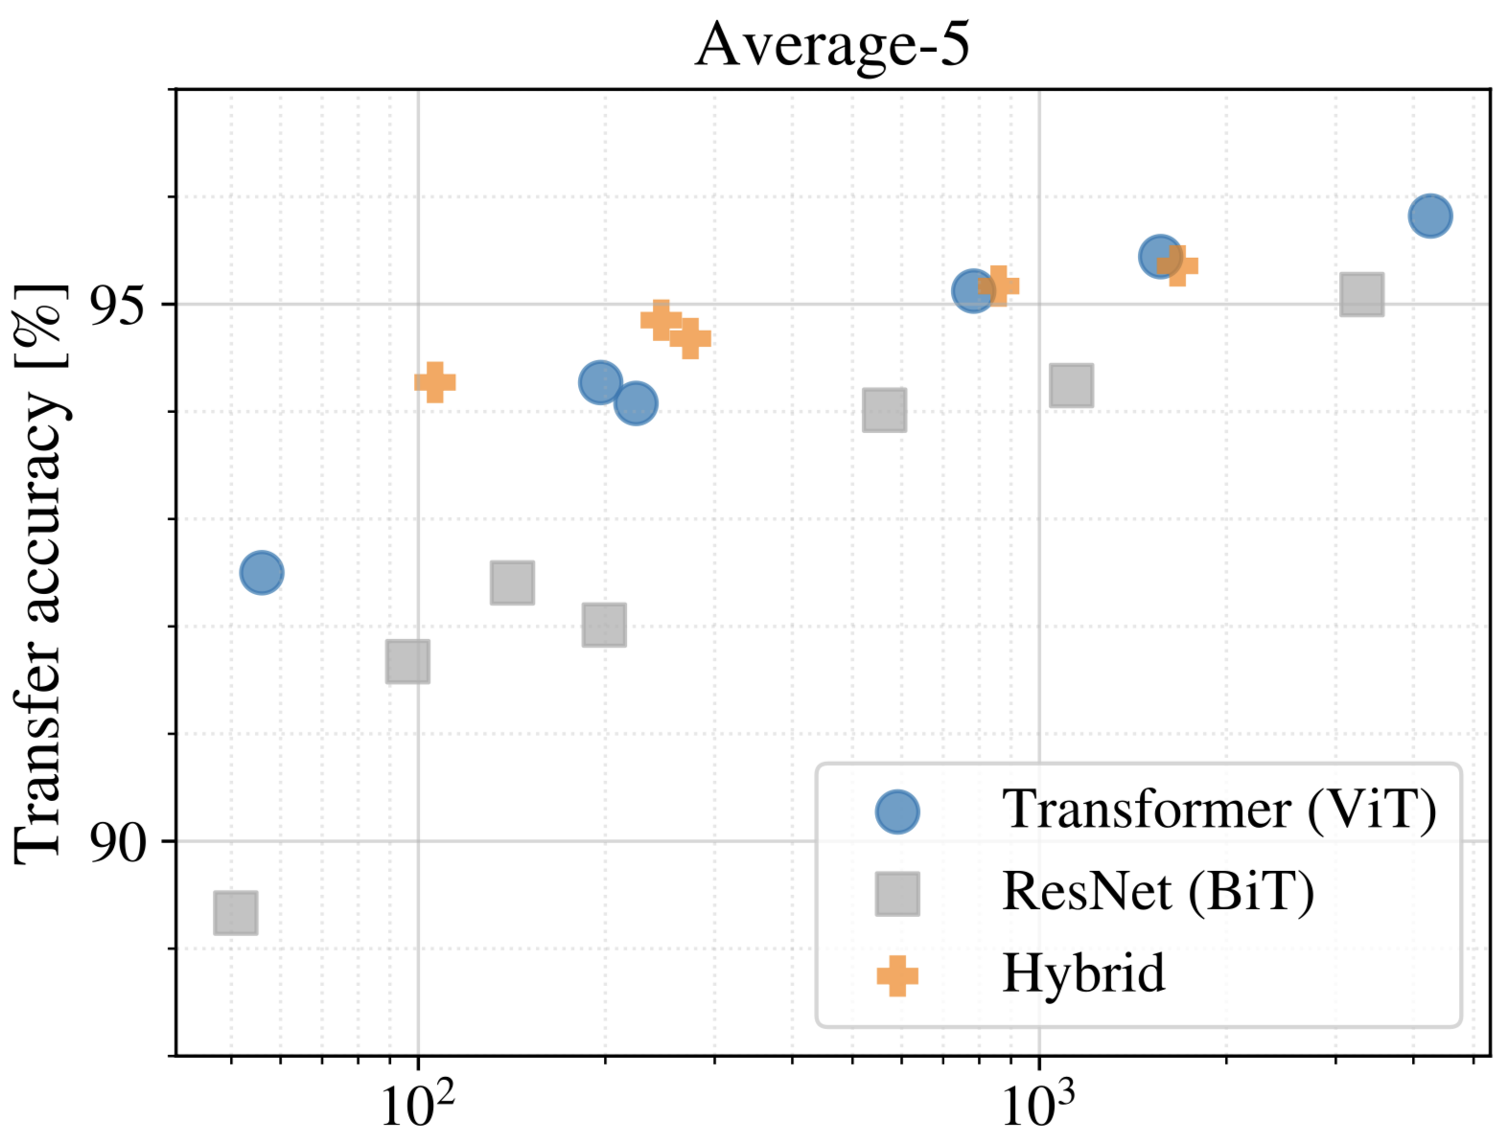
Vision Transformer vs SOTA CNN(ResNet)
Pre-training compute(in ExaFLOPs)
Exa: 10¹⁸, 1 FLOP = 1 multiply-add(wx+b) per second
FLOPs: floating point operations per second

Slide 35
Vision Transformer vs SOTA CNN(ResNet)
Pre-training compute
ViT clearly outperforms ResNet on performance/compute trade-off.
Pre-training compute(in ExaFLOPs)
Exa: 10¹⁸, 1 FLOP = 1 multiply-add(wx+b) per second
FLOPs: floating point operations per second

Slide 36
Vision Transformer vs SOTA CNN(ResNet)
Pre-training compute
ViT clearly outperforms ResNet on performance/compute trade-off.
ViT uses approximately 2-4x less compute to achieve the same transfer accuracy(average of all downstream datasets).
Pre-training compute(in ExaFLOPs)
Exa: 10¹⁸, 1 FLOP = 1 multiply-add(wx+b) per second
FLOPs: floating point operations per second

Slide 37
Vision Transformer vs SOTA CNN(ResNet)
Pre-training compute
ViT clearly outperforms ResNet on performance/compute trade-off.
ViT uses approximately 2-4x less compute to achieve the same transfer accuracy(average of all downstream datasets).
Hybrid(CNN+ViT) slightly outperforms ViT on relatively small compute, but vanishes on large compute budget.
Pre-training compute(in ExaFLOPs)
Exa: 10¹⁸, 1 FLOP = 1 multiply-add(wx+b) per second
FLOPs: floating point operations per second

Slide 38
Vision Transformer vs SOTA CNN(ResNet)
Pre-training compute
ViT clearly outperforms ResNet on performance/compute trade-off.
ViT uses approximately 2-4x less compute to achieve the same transfer accuracy(average of all downstream datasets).
Hybrid(CNN+ViT) slightly outperforms ViT on relatively small compute, but vanishes on large compute budget.
ViT shows extreme scaling behavior. Its performance doesn’t seem to saturate for increased compute.
Pre-training compute(in ExaFLOPs)
Exa: 10¹⁸, 1 FLOP = 1 multiply-add(wx+b) per second
FLOPs: floating point operations per second

Slide 39
Inspecting ViT Representation
Vision Transformer shows remarkable performance when trained on massive datasets. How does it processes images internally?

Slide 40
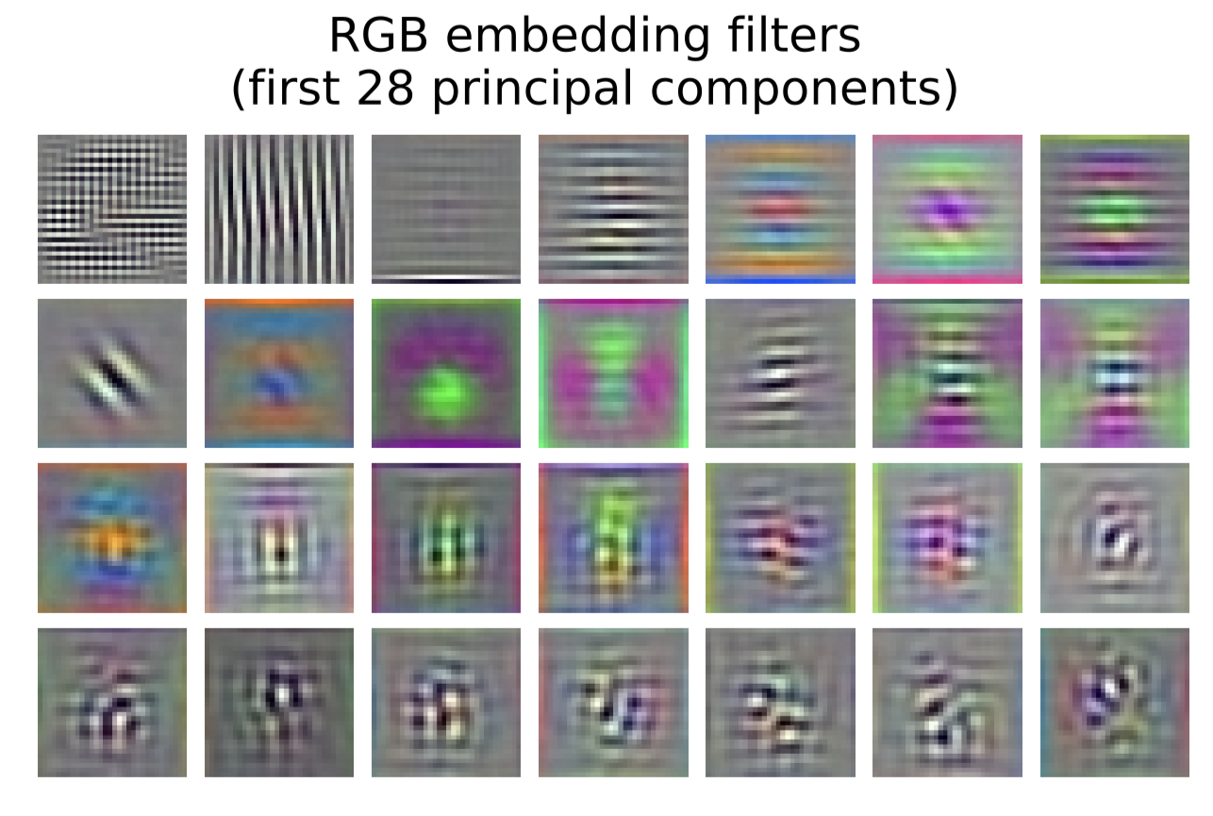
Inspecting ViT Representation
Vision Transformer shows remarkable performance when trained on massive datasets. How does it processes images internally?
The visualized linear embedding of flattened patches shows that the first layer of ViT(linear projection) learns the low level features(such as edges, blobs) of the input image much like ConvNets do!

Slide 41
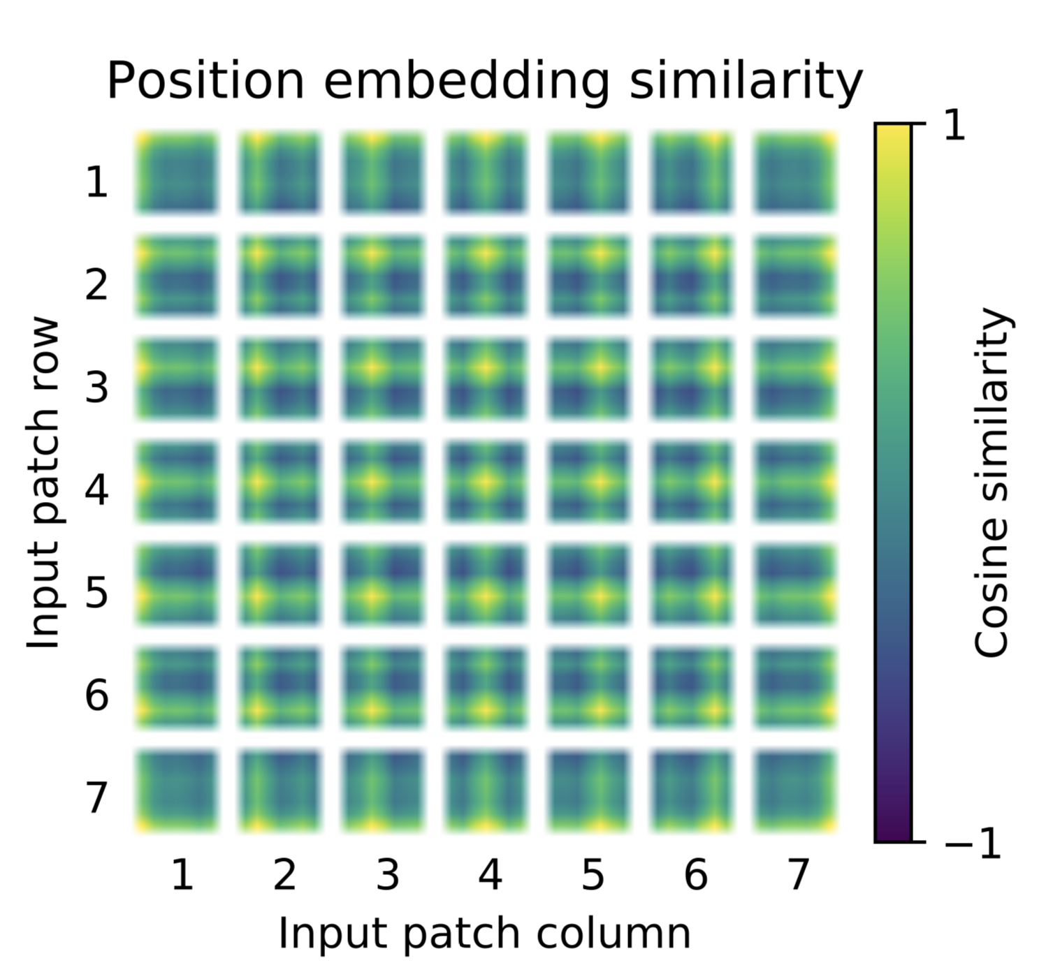
Inspecting ViT Representation
Vision Transformer shows remarkable performance when trained on massive datasets. How does it processes images internally?
Vision Transformer(ViT) learns to encode the distance within the image in the similarity of position embeddings.
Closer patches are likely to have similar position embeddings.
The row-column structure is also maintained for all patches. The patches in the same row and column have similar embeddings.

Slide 42
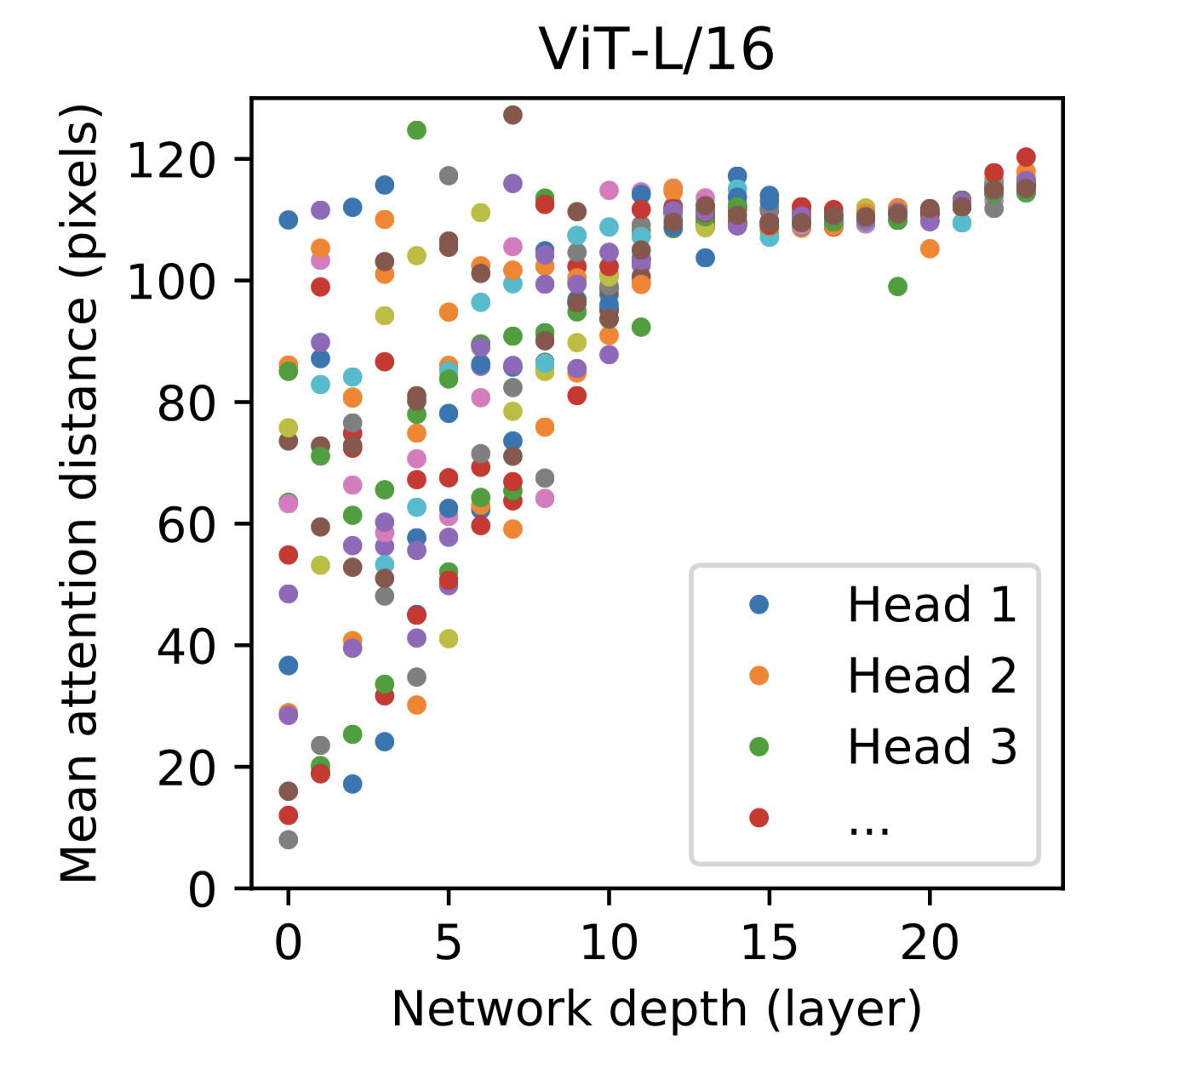
Inspecting ViT Representation
Vision Transformer shows remarkable performance when trained on massive datasets. How does it processes images internally?
Size of attended area by head and network depth
Each dot represents the mean attention distance(analogous to receptive field size in CNN) across images for every head(of 16 heads) and layer.
Mean attention distance increases with layers but some heads attends to most of image even in early layers.
Attention can attend to the whole image with fewer layers than CNNs.

Slide 43
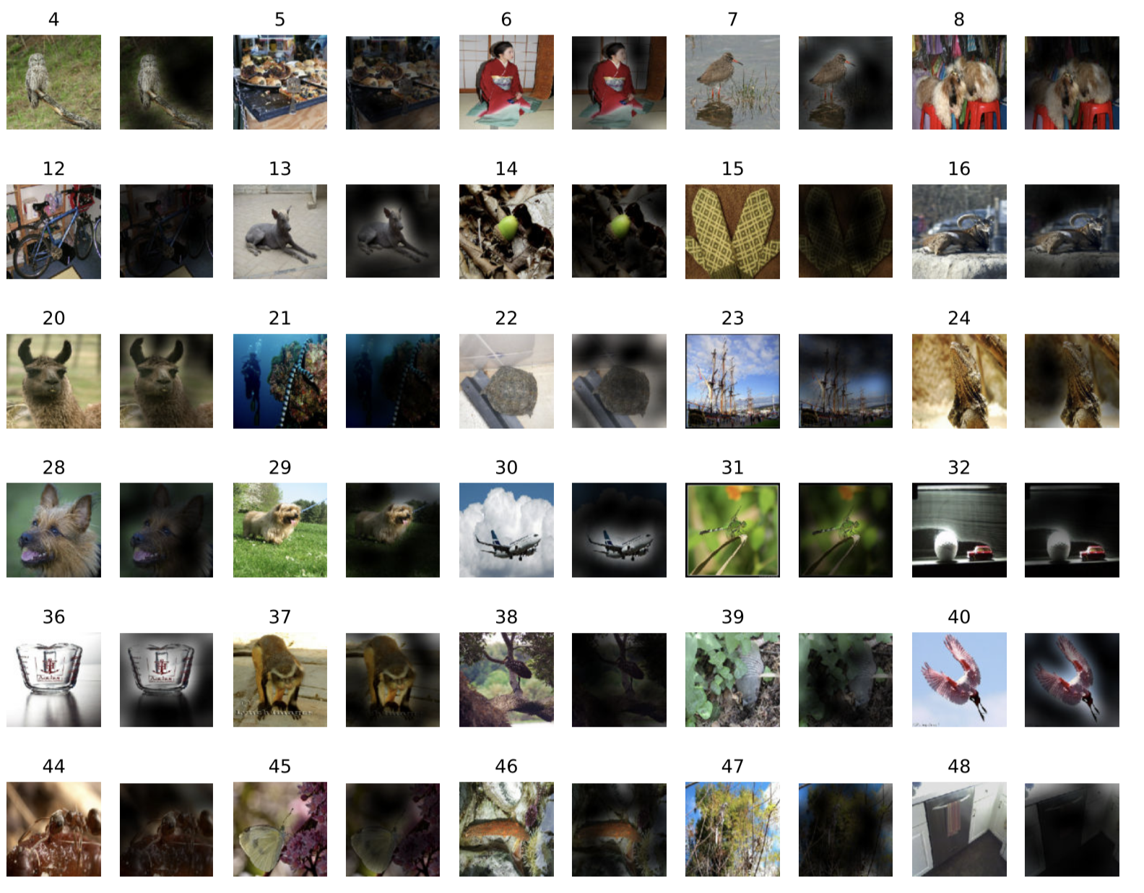

Inspecting ViT Representation
Vision Transformer shows remarkable performance when trained on massive datasets. How does it processes images internally?
On global level, ViT attends to the meaningful part of the image and ignore the rest.

Slide 44
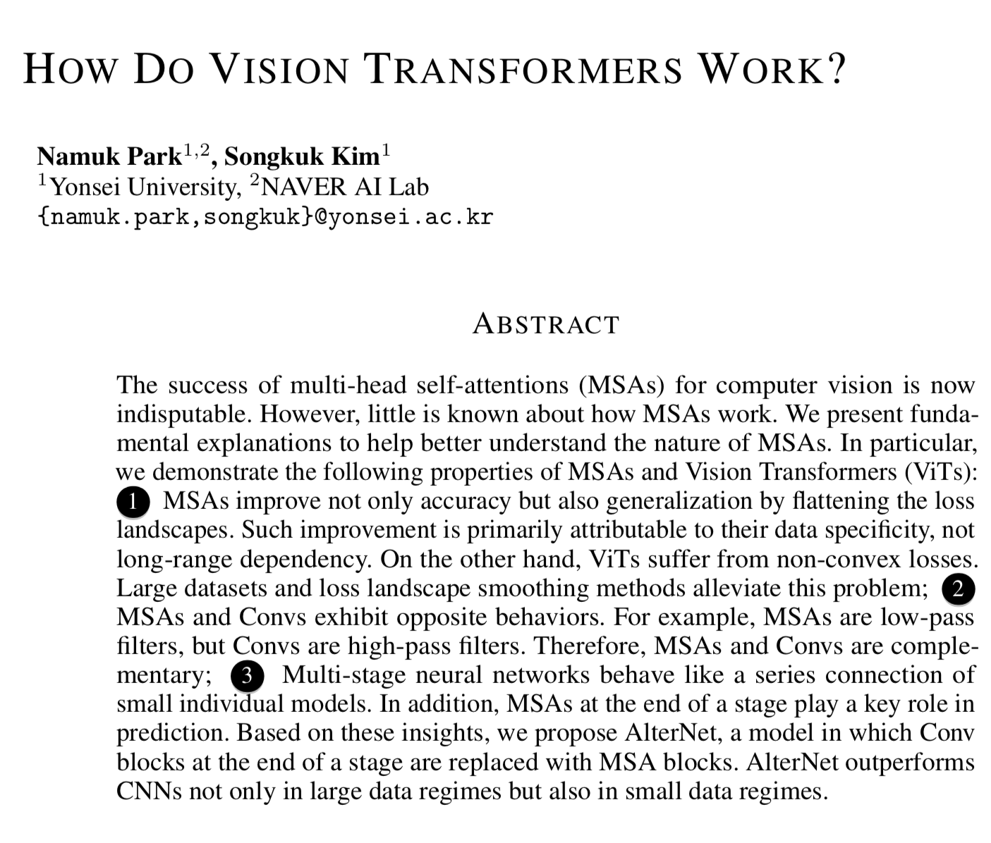
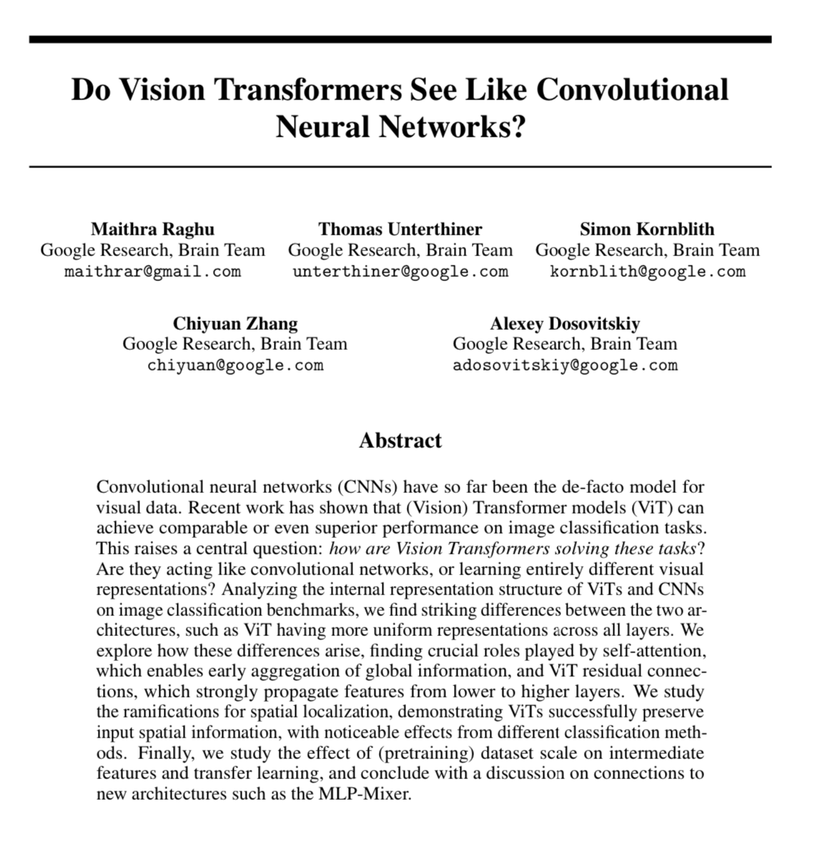
Inspecting ViT Representation
The representations learned by ViT were more explored in recent works. A few of them:

Slide 45
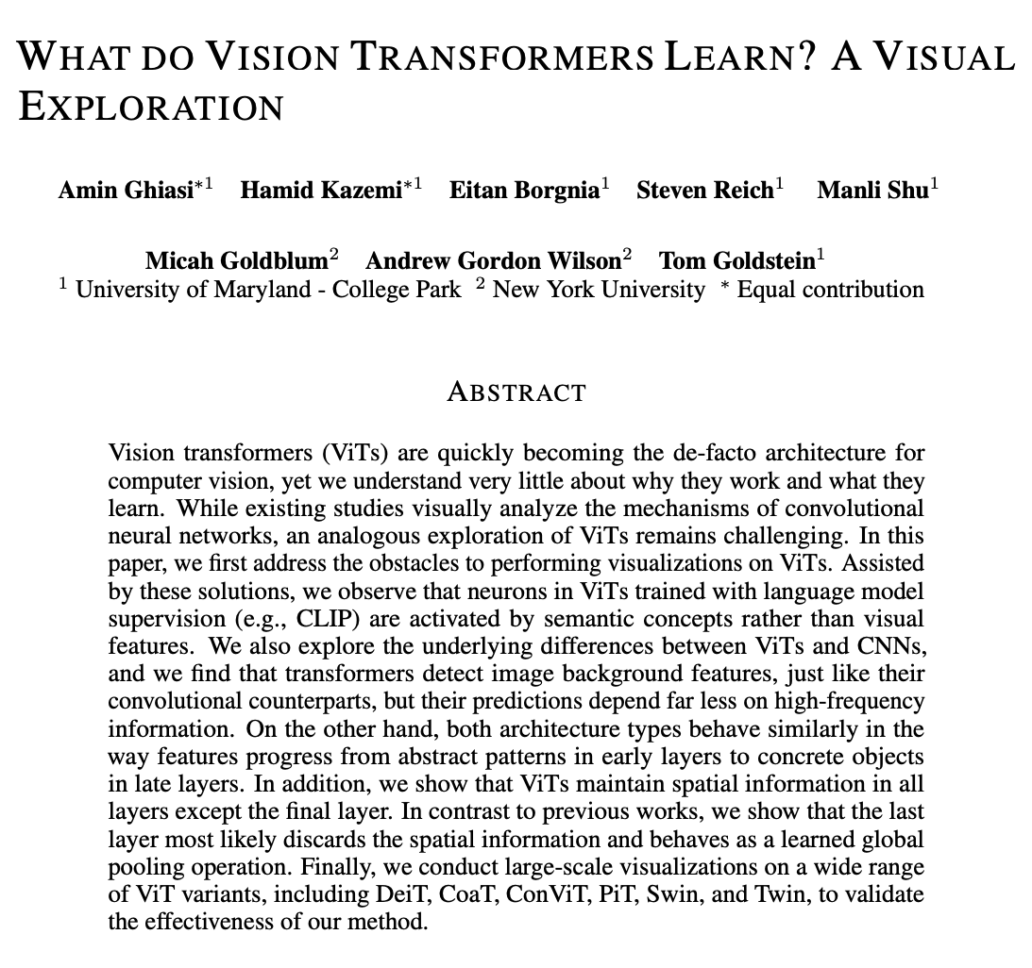
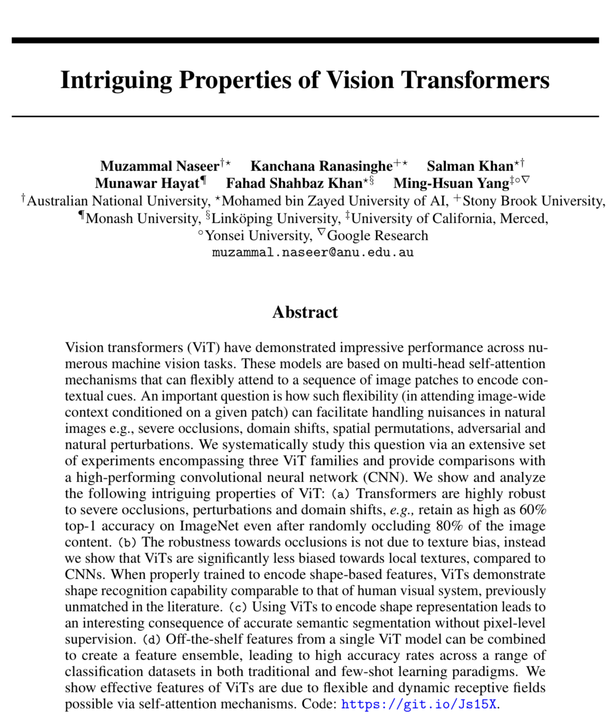
Inspecting ViT Representation
The representations learned by ViT were more explored in recent works. A few of them:

Slide 46
Self-supervision
Most of Transformers success in NLP is the result of large-scale self-supervised pre-training where Transformer is trained on massive unlabelled data from the web.

Slide 47
Self-supervision
Most of Transformers success in NLP is the result of large-scale self-supervised pre-training where Transformer is trained on massive unlabelled data from the web.
Using masked work prediction technique that were used in BERT(randomly masking words in input sentence), ViT designers also tried the same technique where they masked 50% of patches(masked patch prediction) but achieved less performance than supervised pre-training(79.9% ACC on ImageNet while supervised pre-training is ~85%).
Masked-word prediction in BERT
Masked patch prediction ViT
Transformer is an efficient deep learning architecture
Transformer Encoder
ViT
Transformer is an efficient deep learning architecture

Slide 48


ViTs Vs ConvNets

Slide 49
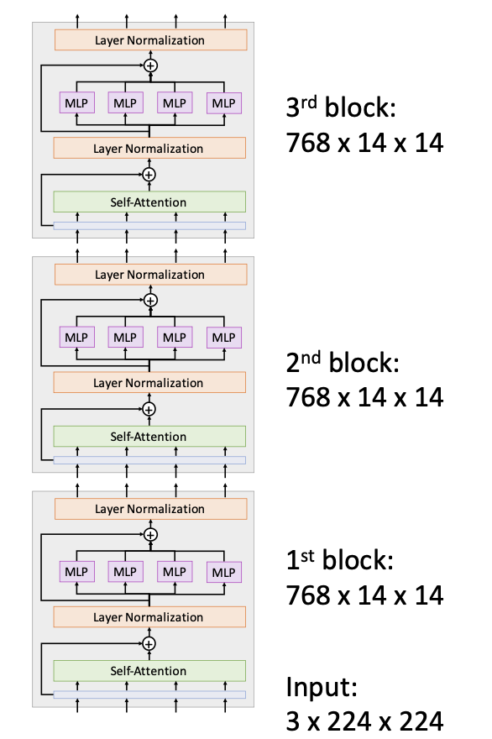
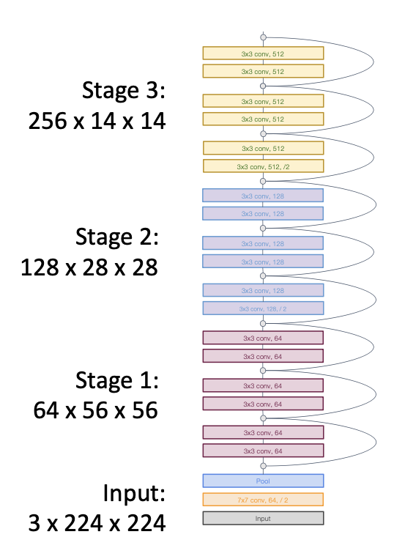
ViTs Vs ConvNets
ViTs and ConvNets can both learn useful representations but they are fundamentally different. ViTs are isotropic architectures(maintain same resolutions and number of channels across the whole network) where as ConvNets are hierarchical(resolution decrease and channel increase with depth).
ViT is isotropic architecture - maintain same resolution and channels across in all blocks
ConvNets are hierarchical. Resolution decrease with depth. Channel increase with depth.
Image: Justin Johnson

Slide 50
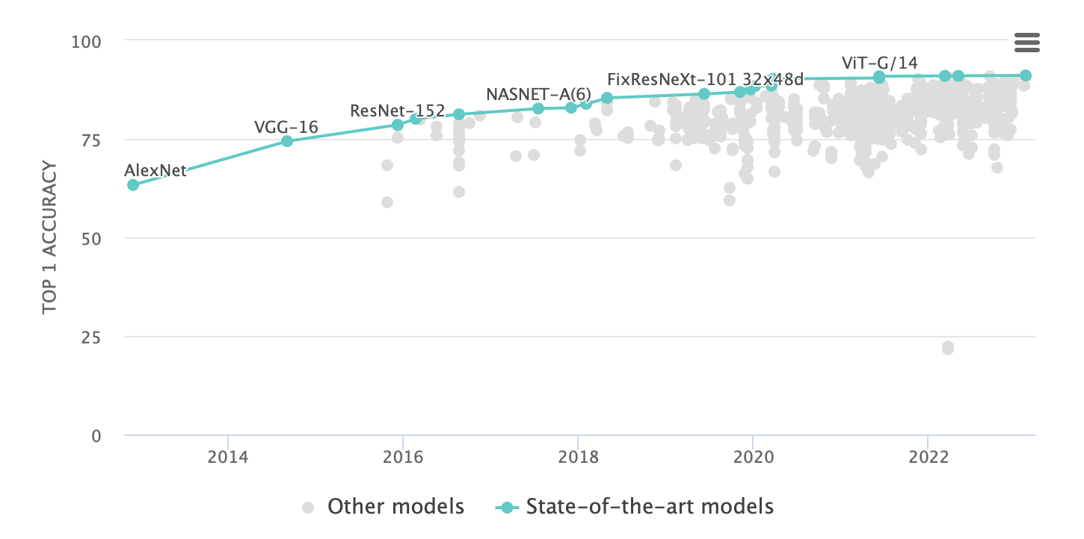
ViTs Vs ConvNets - Which is better?
Vision Transformers are one of the greatest and recent remarkable papers in visual representation learning. They have outperformed ConvNets on various benchmarks, but it is still an open research question whether they will replace ConvNets or not.
ViT was once SOTA on popular computer vision benchmarks such as ImageNet and Cifar100.
SOTA on ImageNet classification. Source: Paper with Code

Slide 51
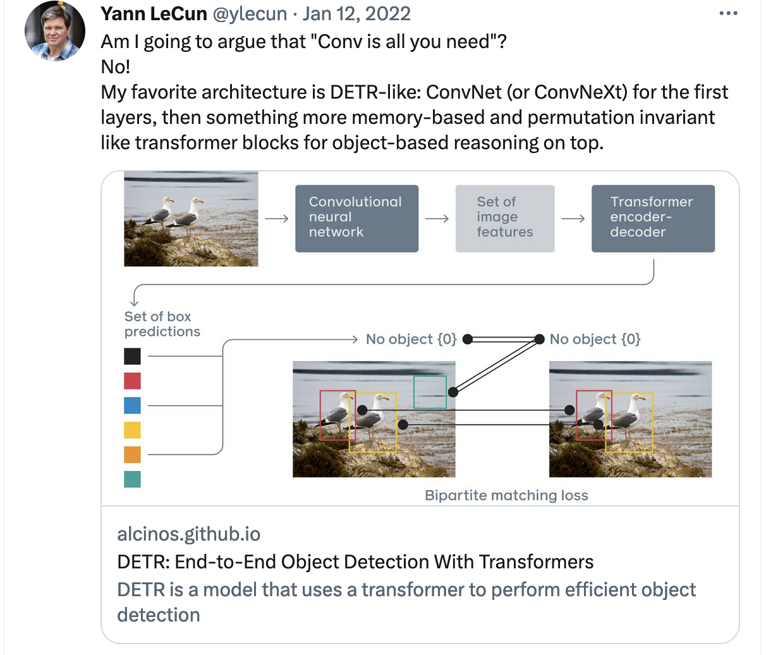

ViTs Vs ConvNets - Which is better?
Vision transformers are an evolution, not a revolution. We can still fundamentally solve the same problems as with CNNs.
Main benefit is probably speed: Matrix multiply is more hardware- friendly than convolution, so ViTs with same FLOPs as CNNs can train and run much faster.
Justin Johnson, University of Michigan
https://twitter.com/ylecun/status/1481198016266739715

Slide 52
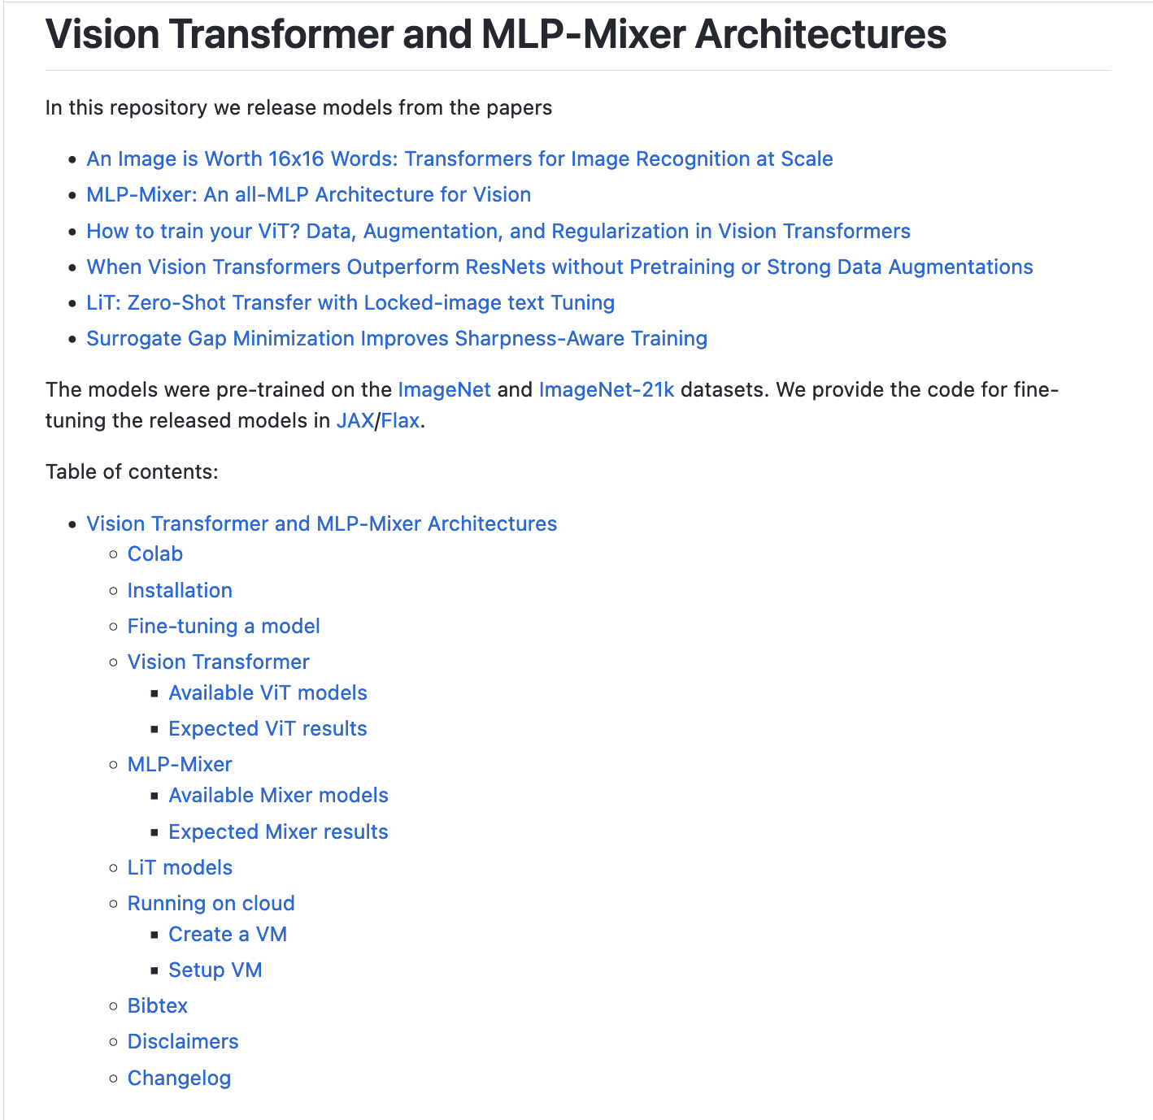
ViTs Implementations
Vision Transformer repository is the official implementation of Vision Transformers in JAX/Flax. It also contain other related models such as MLP-Mixer.
https://github.com/google-research/vision_transformer

Slide 53
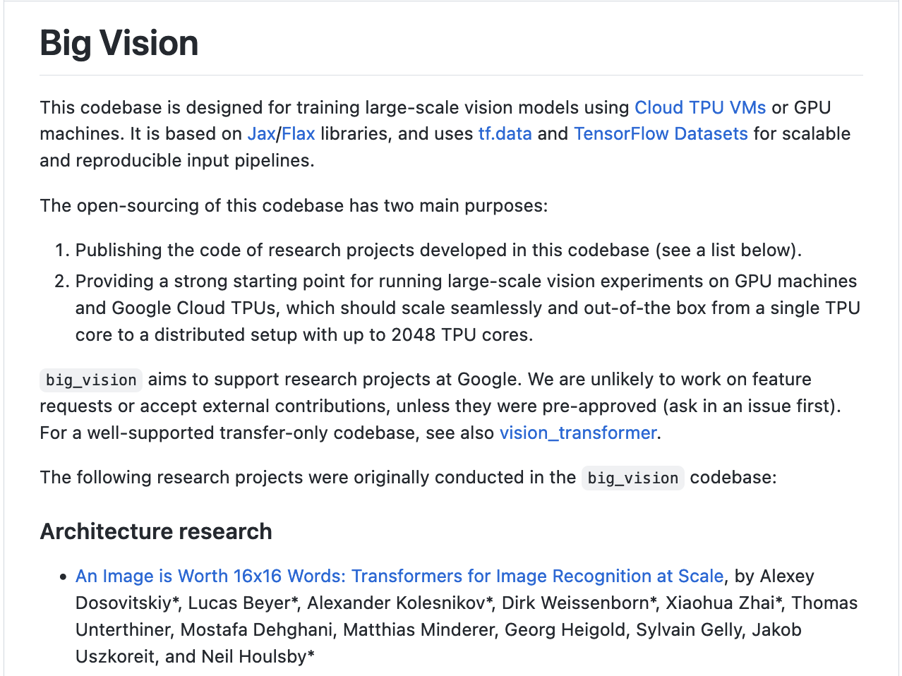
ViTs Implementations
Big Vision is another codebase of ViT and other related models/papers. It contains checkpoints and instructions for training/fine-tuning ViT models.
https://github.com/google-research/big_vision

Slide 54
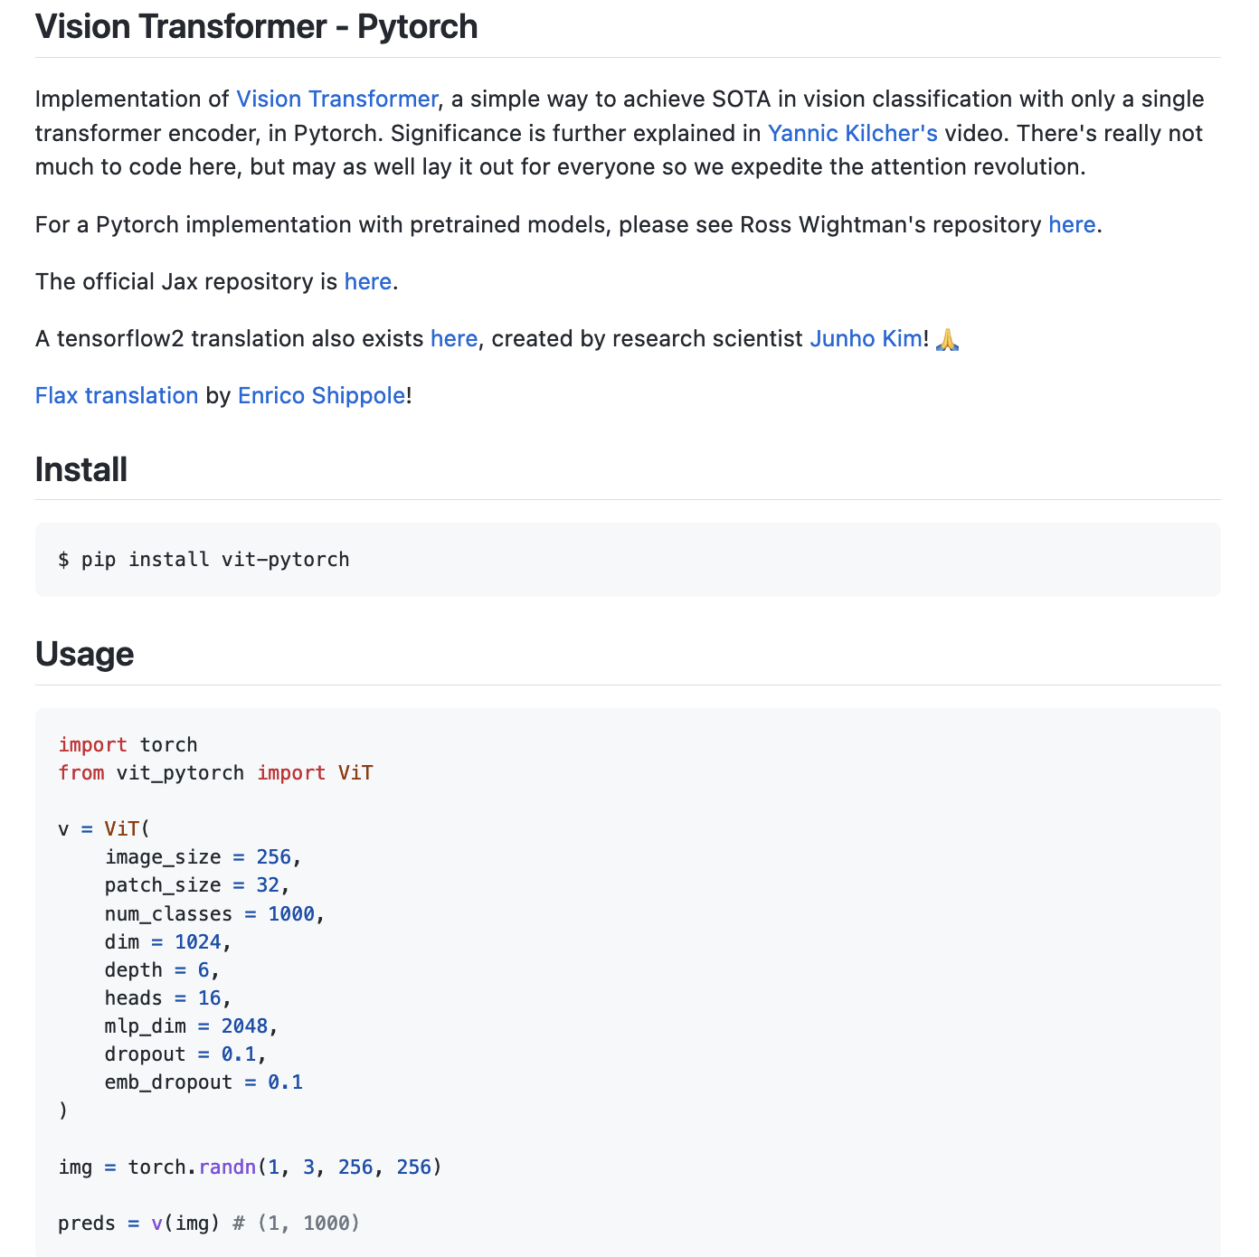
ViTs Implementations
Vision Transformer Pytorch contains implementation of ViT and other popular Vision Transformer models.
https://github.com/lucidrains/vit-pytorch

Slide 55
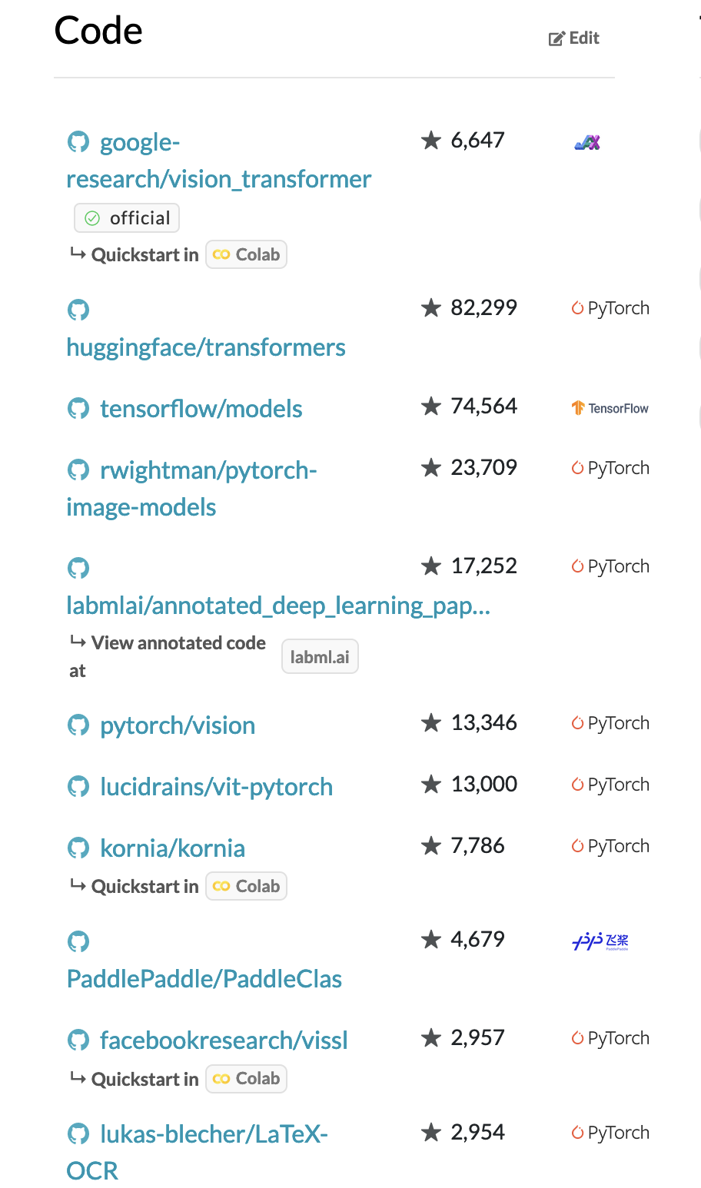

Other ViT implementations on Paper With Code
https://paperswithcode.com/paper/an-image-is-worth-16x16-words-transformers-1

Slide 56
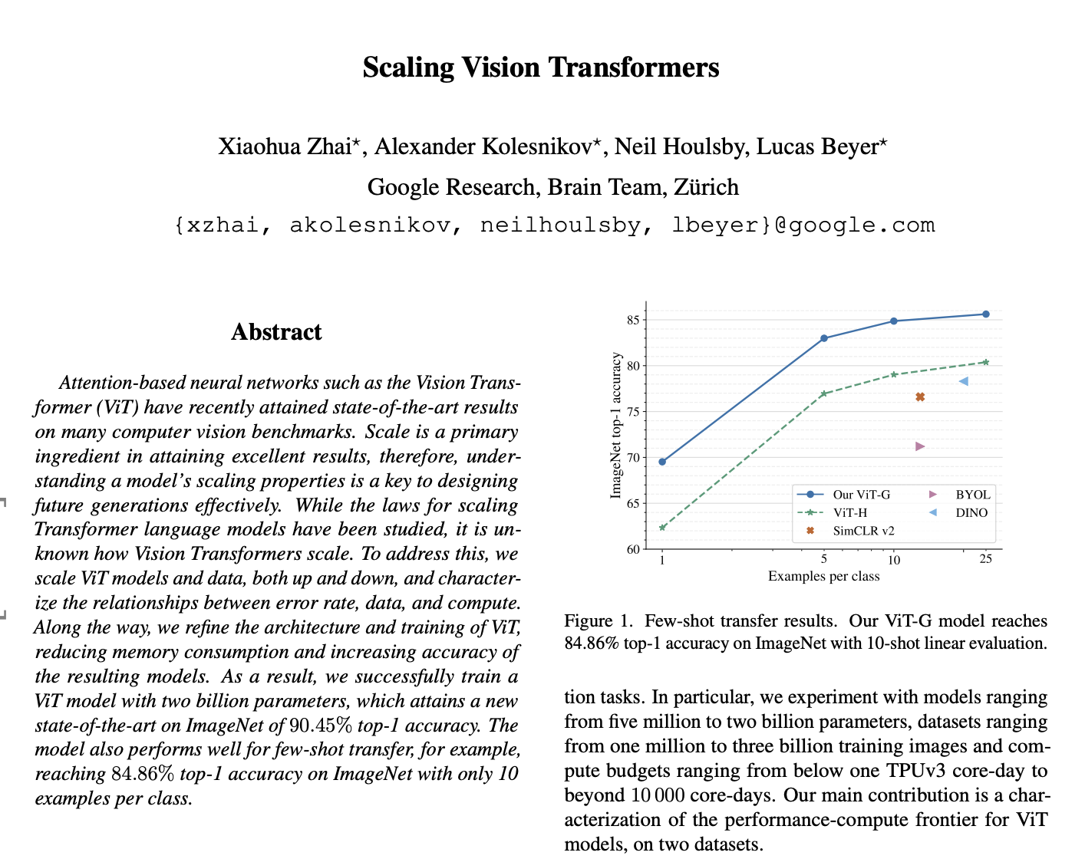
ViT - Follow-up Works
Successfully train ViT of 2B parameters and achieve 90.45% top-1 accuracy on ImageNet.
Notes:
Each one >> Each slide with main key take aways.

Slide 57
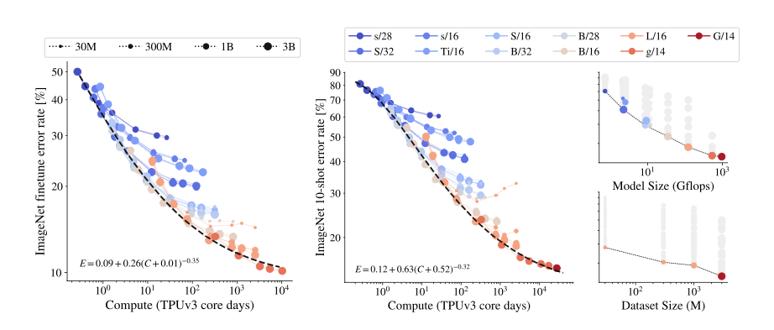
ViT - Follow-up Works
ViT of different sizes
Smaller models: blue shading, large models: red shading
Size of marker: size of training data
Models trained on fewer images: small markers
Models trained for fewer images(small markers) saturates and stop improving when trained for longer.
Zhai et al., “Scaling Vision Transformers”, 2022
Notes:
Each one >> Each slide with main key take aways.

Slide 58
ViT - Follow-up Works
ViT of different sizes
Smaller models: blue shading, large models: red shading
Size of marker: size of training data
Models trained on fewer images: small markers
Models trained for fewer images(small markers) saturates and stop improving when trained for longer.
Scaling up compute, model and data together improves representation quality.
Zhai et al., “Scaling Vision Transformers”, 2022
Notes:
Each one >> Each slide with main key take aways.

Slide 59
ViT - Follow-up Works
ViT of different sizes
Smaller models: blue shading, large models: red shading
Size of marker: size of training data
Models trained on fewer images: small markers
Models trained for fewer images(small markers) saturates and stop improving when trained for longer.
Scaling up compute, model and data together improves representation quality.
A model (one with connected points) with largest size, dataset size, and compute achieves the lowest error rate. This is consistent across fine-tuning and few-shot learning.
Zhai et al., “Scaling Vision Transformers”, 2022
Notes:
Each one >> Each slide with main key take aways.

Slide 60
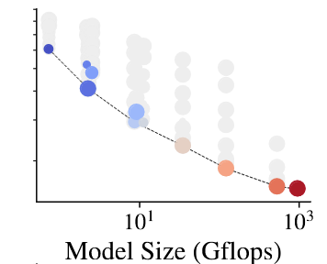
ViT - Follow-up Works
ViT of different sizes
Smaller models: blue shading, large models: red shading
Size of marker: size of training data
Models trained on fewer images: small markers
Representation quality is bottlenecked by model size. Small models are not able to benefit from either the largest data or compute resources while large models benefit from both.
Zhai et al., “Scaling Vision Transformers”, 2022
Notes:
Each one >> Each slide with main key take aways.

Slide 61
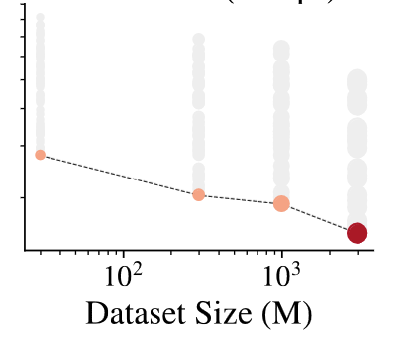
ViT - Follow-up Works
ViT of different sizes
Smaller models: blue shading, large models: red shading
Size of marker: size of training data
Models trained on fewer images: small markers
When scaling up the model size, the representation quality is limited by small datasets. Large models benefit from increased dataset but smaller models are hurted by large datasets.
Zhai et al., “Scaling Vision Transformers”, 2022
Notes:
Each one >> Each slide with main key take aways.

Slide 62
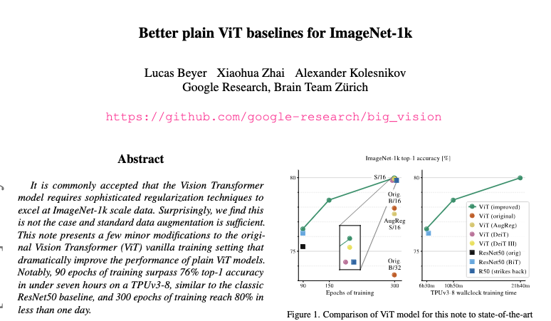
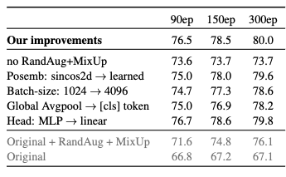
ViT - Follow-up Works
Simple ViT can achieve comparable performance to ResNet with few modifications: standard data augmentation, using fixed positional embeddings instead of learnable embeddings, batchsize of 1024 instead of 4096, global average pool instead of extra class token, MLP head instead of linear head.
Notes:
Each one >> Each slide with main key take aways.

Slide 63
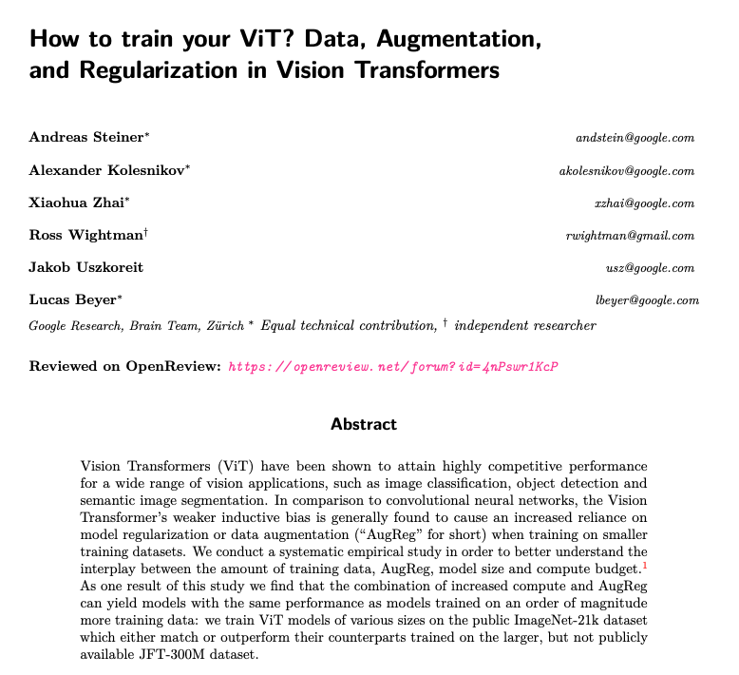
ViT - Follow-up Works
Problem with ViTs: Training ViTs require an insane amount of training data. What’s the interplay between amount of training data, augmentation/regularization, model size, and compute budget?
Notes:
Each one >> Each slide with main key take aways.

Slide 64
ViT - Follow-up Works
Problem with ViTs: Training ViTs require an insane amount of training data. What’s the interplay between amount of training data, augmentation/regularization, model size, and compute budget?
The paper showed that carefully selected amount of regularization and data augmentation can compensate for ViT’s need of more training data. In particular, a good mix of regularization and augmentations roughly corresponds to a 10x increase in training data size.
Notes:
Each one >> Each slide with main key take aways.

Slide 65
ViT - Follow-up Works
Problem with ViTs: Training ViTs require an insane amount of training data. What’s the interplay between amount of training data, augmentation/regularization, model size, and compute budget?
The paper showed that carefully selected amount of regularization and data augmentation can compensate for ViT’s need of more training data. In particular, a good mix of regularization and augmentations roughly corresponds to a 10x increase in training data size.
Regularization: weight decay, stochastic depth, dropout(in FC)
Data augmentation: mixup, randaugment
Notes:
Each one >> Each slide with main key take aways.

Slide 66
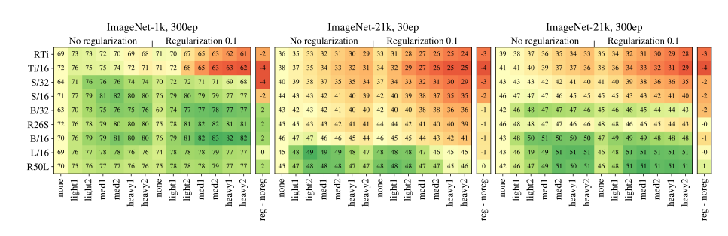
ViT - Follow-up Works
For small datasets, both regularization and data augmentation help.
Augmentation
Steiner et al, “How to train your ViT? Data, Augmentation, and Regularization in Vision Transformers”, 2021
Notes:
Each one >> Each slide with main key take aways.

Slide 67
ViT - Follow-up Works
For small datasets, both regularization and data augmentation help.
For medium-large datasets, both regularization and data augmentation hurt when training compute is fixed.
Augmentation
Steiner et al, “How to train your ViT? Data, Augmentation, and Regularization in Vision Transformers”, 2021
Notes:
Each one >> Each slide with main key take aways.

Slide 68
ViT - Follow-up Works
For small datasets, both regularization and data augmentation help.
For medium-large datasets, both regularization and data augmentation hurt when training compute is fixed.
For medium-large datasets, both regularization and data augmentation yield better accuracy for increased training compute(ie, 30ep → 300ep).
Augmentation
Steiner et al, “How to train your ViT? Data, Augmentation, and Regularization in Vision Transformers”, 2021
Notes:
Each one >> Each slide with main key take aways.

Slide 69
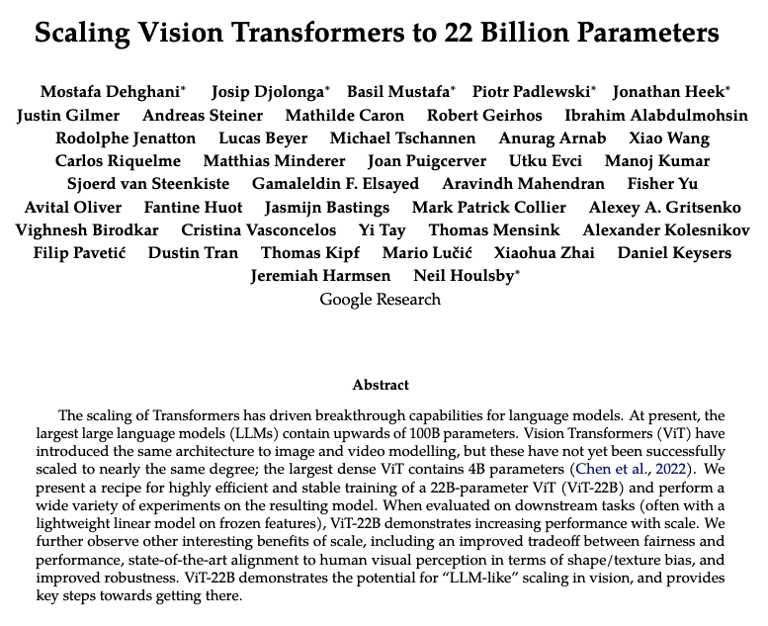
ViT - Follow-up Works
Language models(LM) can be scaled to over 100B parameters. Largest ViT model contains 4B parameters by far.
Both use almost same transformer. Why can’t ViT models be scaled to more billions parameters?
The paper presents the largest dense 22B ViT model(to date) along with its training recipes.

Slide 70
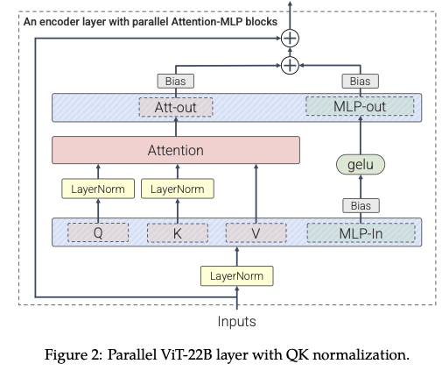
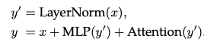
ViT - Follow-up Works
ViT-22B is roughly an original ViT with three main architectural changes.
Parallel layers: Instead of arranging Attention and MLPs blocks in series, ViT-22B applies them in parallel.
Original ViT
Dehghani et al., “Scaling Vision Transformers to 22 Billion Parameters, 2023

Slide 71
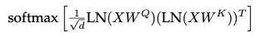
ViT - Follow-up Works
ViT-22B is roughly an original ViT with three main architectural changes.
Parallel layers: Instead of arranging Attention and MLPs blocks in series, ViT-22B applies them in parallel.
Applying normalization(LayerNorm) to queries Q and keys K: when attention logits are extremely large, attention weights can vanish. Q and K are fed through LayerNorm before dot product attention to stabilize the training.
Dehghani et al., “Scaling Vision Transformers to 22 Billion Parameters, 2023

Slide 72
ViT - Follow-up Works
ViT-22B is roughly an original ViT with three main architectural changes.
Parallel layers: Instead of arranging Attention and MLPs blocks in series, ViT-22B applies them in parallel.
Applying normalization(LayerNorm) to queries Q and keys K: when attention logits are extremely large, attention weights can vanish. Q and K are fed through LayerNorm before dot product attention to stabilize the training.
Omitting bias terms in QKV projections and LayerNorms: Following previous novel works like PaLM, ViT-22B suppresses biases terms in QKV linear projections layers and LayerNorms but keeps them in MLP in & out and Att-out.
Dehghani et al., “Scaling Vision Transformers to 22 Billion Parameters, 2023

Slide 73
ViT - Follow-up Works
ViT-22B improves training and hardware stability, achieves SOTA on several vision benchmarks, and claims to be more aligned with humans for shape and texture bias and more robust compared to existing models based on ViT.
Dehghani et al., “Scaling Vision Transformers to 22 Billion Parameters, 2023

Slide 74
End of the video
Image: Google AI blog

Slide 75
Thank you for your visual attention!

